Slide 1

Software Ranked++
Shahzil Siddiqui Nathan Cameron ViDA Pathan

Slide 2

PROJECT ROLES
SHAHZIL SIDDIQUI
Project Manager
Full Stack Developer
Vlog Editor
NATHAN CAMERON
GitHub Manager
Full Stack Developer
Wiki Page Editor
VIDA PATHAN
Research Manager
Full Stack Developer

Slide 3

Project IDEa
Software Ranking System
Allow certified organizations to rank popular languages
Allowing users to view averaged rankings
Allowing users to learn more about popular languages (pros/cons, syntax, and trends)

Slide 4


Project Reason
To quantitatively illustrate the views of professionals on trending software languages
Gives businesses and Start-ups an overview of highly acclaimed software tools
To provide beginner developers with detail on different software languages

Slide 5
The “Who”
RANKER
Users
VIEWER
Professional Tech. Industries and software “Gurus”
Ambitious Developers & Start-ups

Slide 6

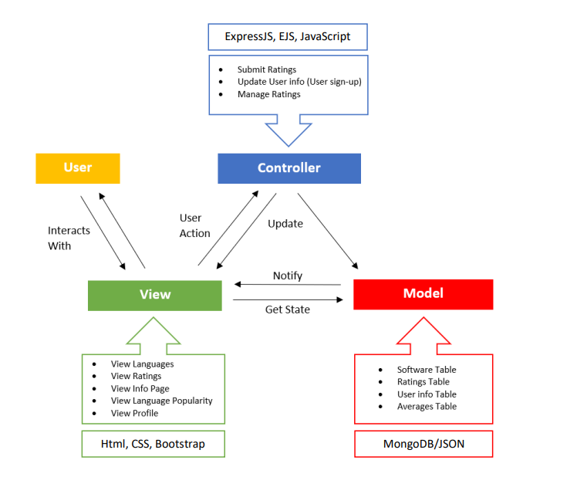
MODEL
VIEW
CONTROLLER

Slide 7
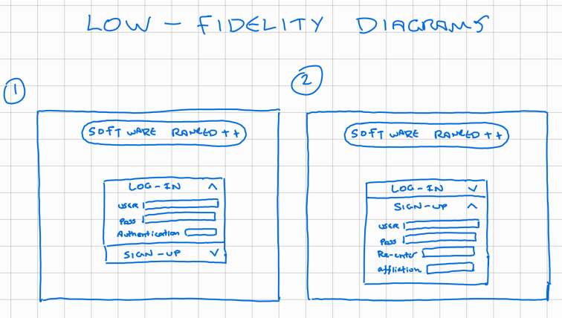
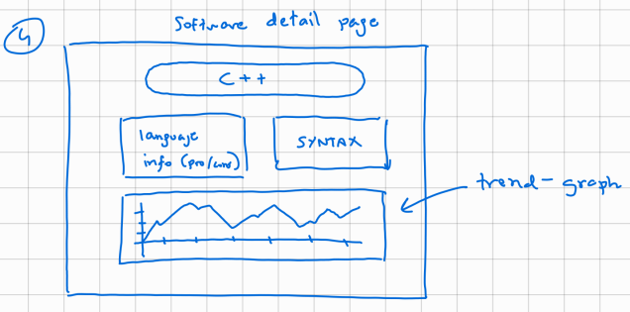
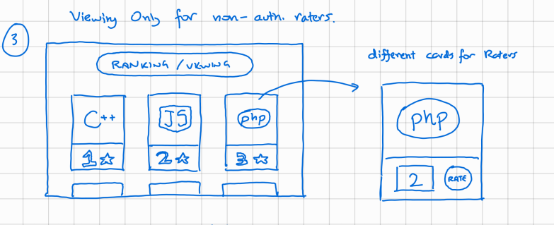
Envisioned Software Design & Structure

Slide 8
KANBAN STRUCTURE!

